Slide 1
Introduction to Statistics for Ecology and Evolutionary Biology Interactions Week 11 06 April 2020

Slide 2
Centering Predictor Variables
Subtract the raw variable mean from each value of the raw variable
Interpretation: a value of 0 for a centered variable corresponds to the mean value of the raw variable
Benefits:
Can improve model fitting
Can improve interpretability of the intercept parameter

Slide 3
Standardizing Predictor Variables
Subtract the raw variable mean from each value of the raw variable and divide by the raw variable’s standard deviation
Or the R function scale() will do this for you
Interpretation: a value of 0 for a standardized variable corresponds to the mean value of the raw variable, and an increase in 1 unit of the standardized variable corresponds to a 1 standard deviation increase in the raw variable
Benefits:
Can improve model fitting
Can improve interpretability of the intercept parameter
Allows easier comparison among predictors in a regression model with multiple predictors (i.e., multiple regression)

Slide 4
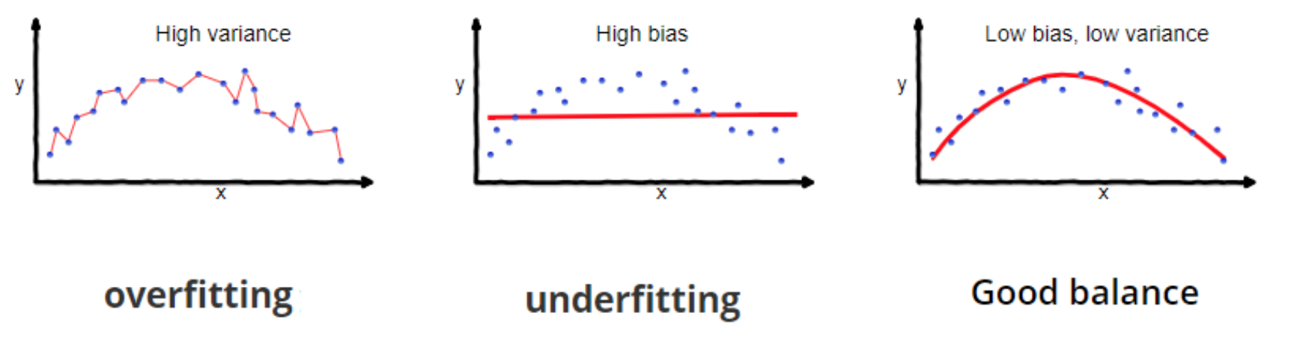
The Bias-Variance Tradeoff
Notes:
The bias-variance tradeoff is another set of terminology you may hear used to describe underfitting and overfitting
A model that is very underfit has high bias
A model that is very overfit has high variance
Note, the word “variance” is used a lot of different ways in statistics
This is one reason to prefer the terms “underfitting” and “overfitting”, it avoids confusion
And again:
When we underfit we learn too little from the data
When we overfit we learn too much from the data
https://towardsdatascience.com/understanding-the-bias-variance-tradeoff-165e6942b229

Slide 5
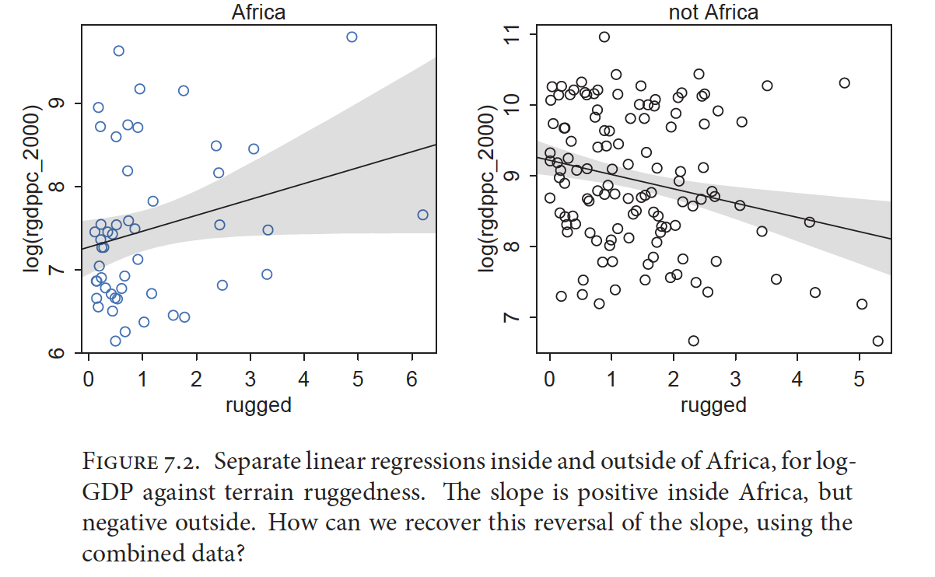
Interactions: What If Predictors Depend Upon Other Predictors?
Notes:
Introduce interactions as conditional predictor relationships
We’re going to build up in this lecture towards generating linear models with interaction terms

Slide 6
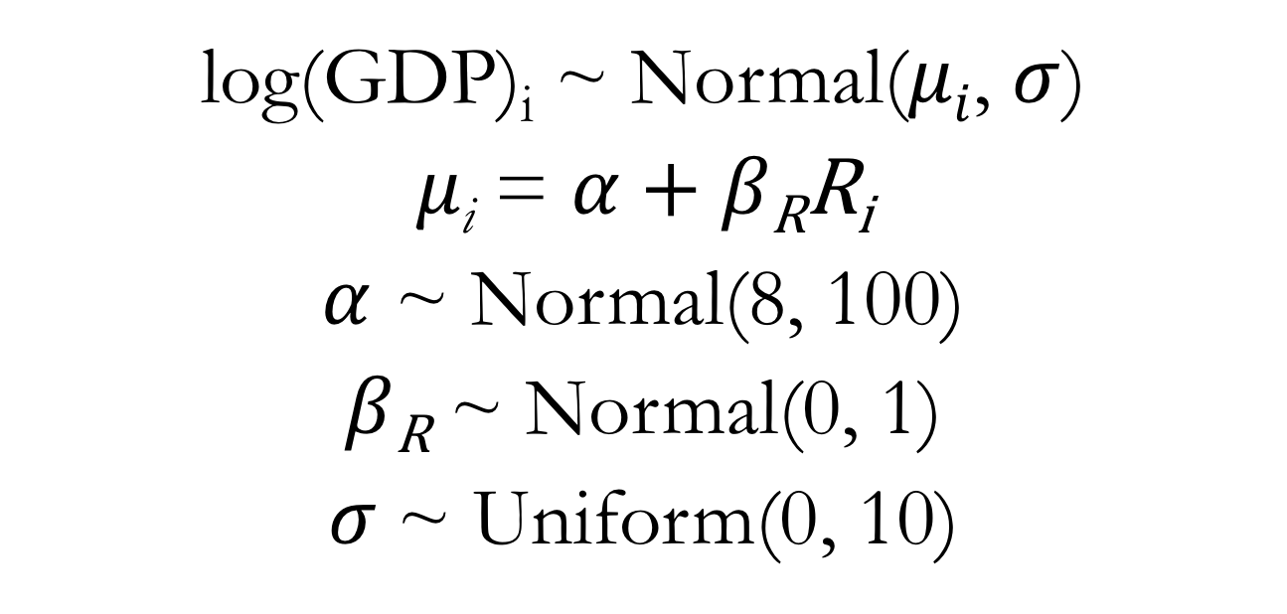
Linear Regression for GDP Predictor: Ruggedness
log(GDP)_{i} ~ Normal($μi$, $σ$)
$μ\text{i}$ = $α$ + $β\text{R}\text{R}\text{i}$
$α$ ~ Normal(8, 100)
$β\text{R}$ ~ Normal(0, 1)
$σ$~ Uniform(0, 10)

Slide 7
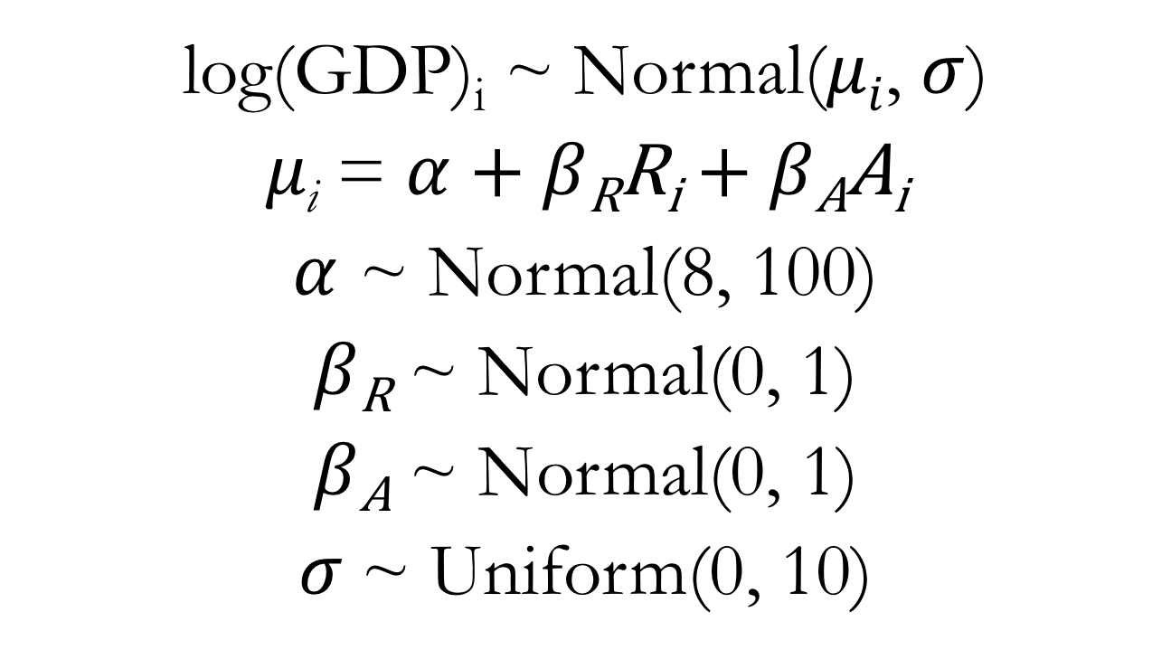
Multiple Regression for GDP Predictors: Ruggedness and Continent Identity
log(GDP)_{i} ~ Normal($μi$, $σ$)
$μ\text{i}$ = $α$ + $β\text{R}\text{R}\text{i}$ + $β\text{A}\text{A}\text{i}$
$α$ ~ Normal(8, 100)
$β\text{R}$ ~ Normal(0, 1)
$β\text{A}$ ~ Normal(0, 1)
$σ$~ Uniform(0, 10)
Notes:
Where Ai is a dummy variable indicating whether or not the country in question is within Africa or not

Slide 8

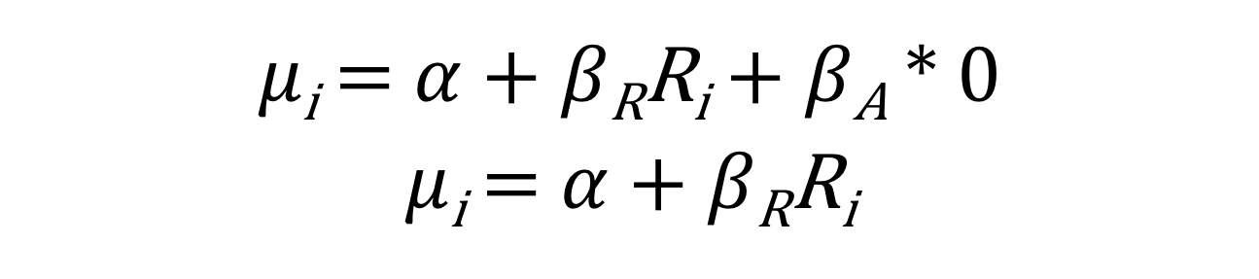
Equation for the Mean
$μ\text{i}$ = $α$ + $β\text{R}\text{R}\text{i}$ + $β\text{A}A\text{i}$
Outside of Africa: A_{i} = 0
$μ\text{i}$ = $α$ + $β\text{R}\text{R}\text{i}$ + $β\text{A}$ * 0
$μ\text{i}$ = $α$ + $β\text{R}\text{R}\text{i}$

Slide 9

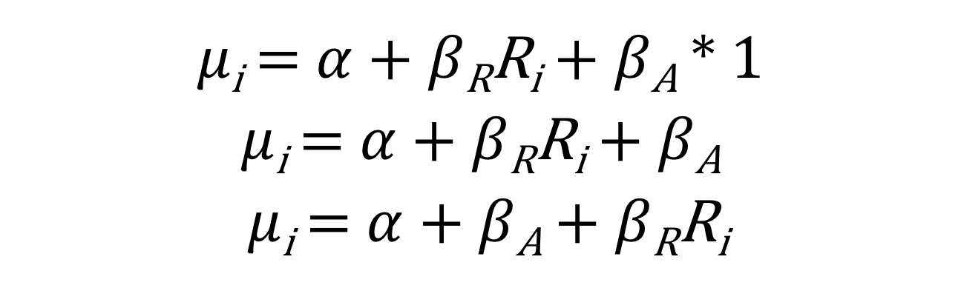
Equation for the Mean
$μ\text{i}$ = $α$ + $β\text{R}\text{R}\text{i}$ + $β\text{A}A\text{i}$
In Africa: A_{i} = 1
$μ\text{i}$ = $α$ + $β\text{R}\text{R}\text{i}$ + $β\text{A}$ * 1
$μ\text{i}$ = $α$ + $β\text{R}\text{R}\text{i}$ + $β\text{A}$
$μ\text{i}$ = $α$ + $β\text{A}$ + $β\text{R}\text{R}\text{i}$

Slide 10
Notes:
Emphasize the unity between many common statistical tests and the procedures we’ve learned in this course (implementing these types of analyses as different forms of regression)
https://lindeloev.github.io/tests-as-linear/
Go to lecture code for model fitting up through interactions

Slide 11
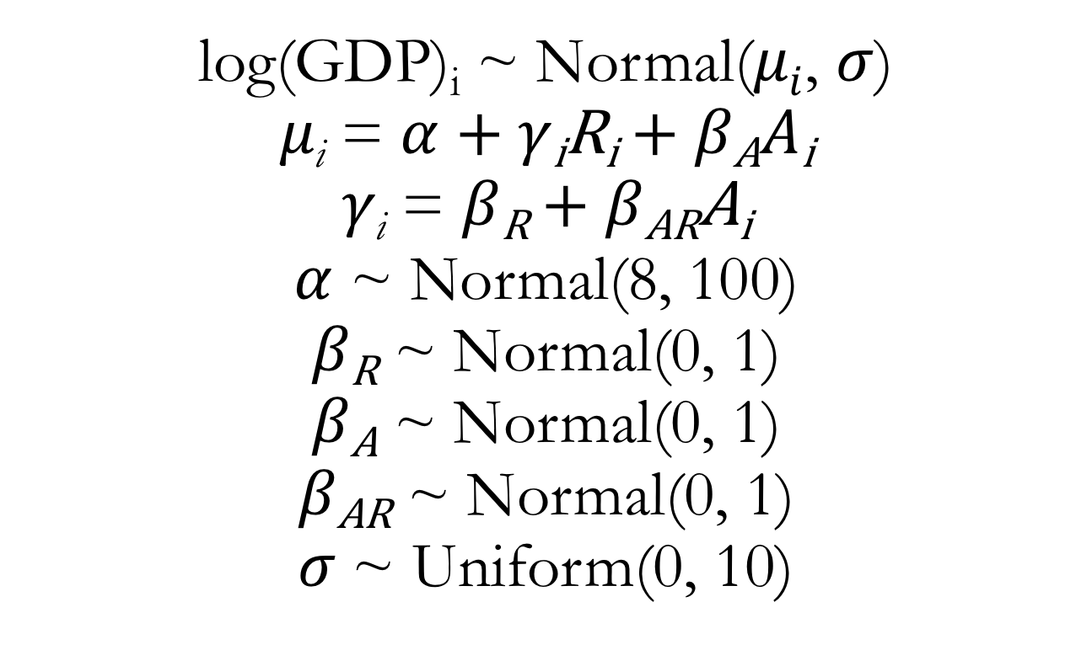
Multiple Regression for GDP Predictors: Ruggedness, Continent Identity, and Interaction
log(GDP)_{i} ~ Normal($μi$, $σ$)
$μ\text{i}$ = $α$ + $γ\text{i}\text{R}\text{i}$ + $β\text{A}A\text{i}$
$γ\text{i}$ = $β\text{R}$ + $β\text{A}\text{R}\text{A}\text{i}$
$α$ ~ Normal(8, 100)
$β\text{R}$ ~ Normal(0, 1)
$β\text{A}$ ~ Normal(0, 1)
$β\text{A}\text{R}$ ~ Normal(0, 1)
$σ$~ Uniform(0, 10)

Slide 12
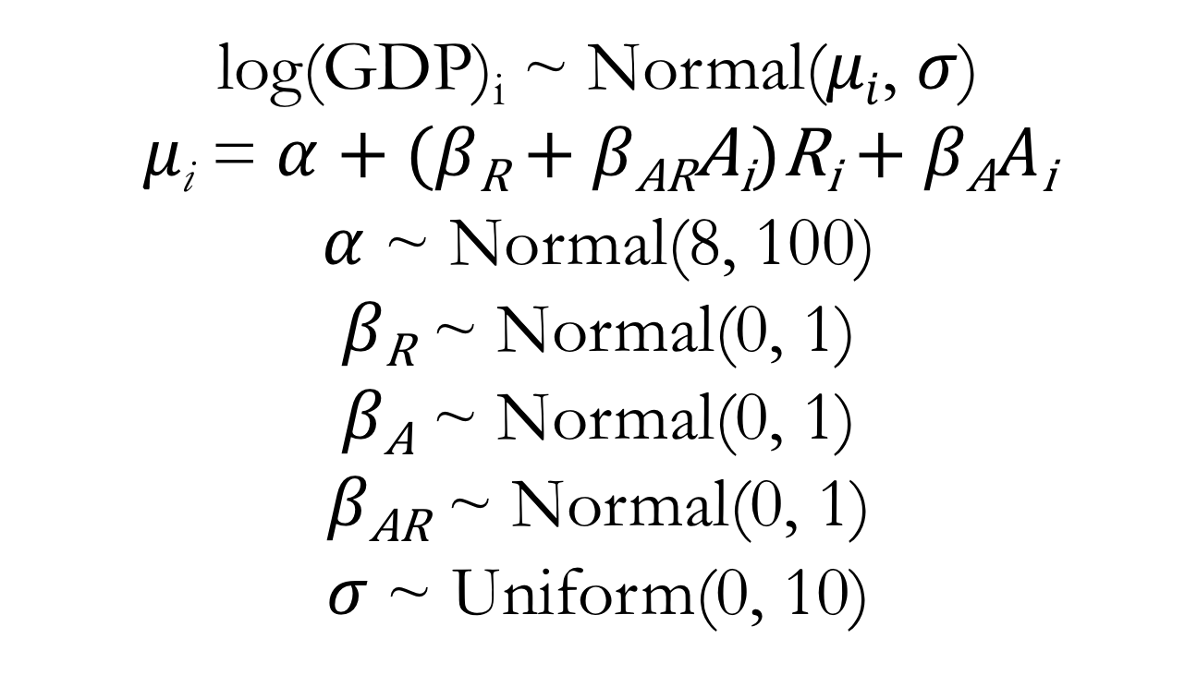
Do Some Math!
log(GDP)_{i} ~ Normal($μi$, $σ$)
$μ\text{i}$ = $α$ + ($β\text{R}$ + $β\text{AR}\text{A}\text{i}$)$\text{R}\text{i}$ + $β\text{A}A\text{i}$
$α$ ~ Normal(8, 100)
$β\text{R}$ ~ Normal(0, 1)
$β\text{A}$ ~ Normal(0, 1)
$β\text{A}\text{R}$ ~ Normal(0, 1)
$σ$~ Uniform(0, 10)

Slide 13
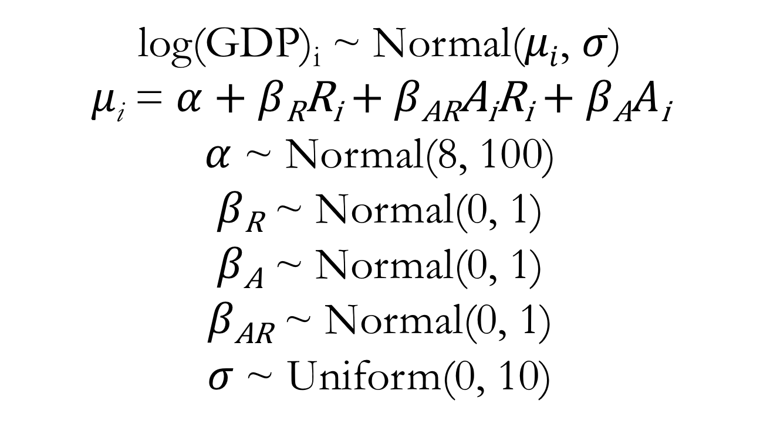
Do Some Math!
log(GDP)_{i} ~ Normal($μi$, $σ$)
$μ\text{i}$ = $α$ + $β\text{R}\text{R}\text{i}$ + $β\text{AR}\text{A}\text{i}\text{R}\text{i}$ + $β\text{A}A\text{i}$
$α$ ~ Normal(8, 100)
$β\text{R}$ ~ Normal(0, 1)
$β\text{A}$ ~ Normal(0, 1)
$β\text{A}\text{R}$ ~ Normal(0, 1)
$σ$~ Uniform(0, 10)

Slide 14
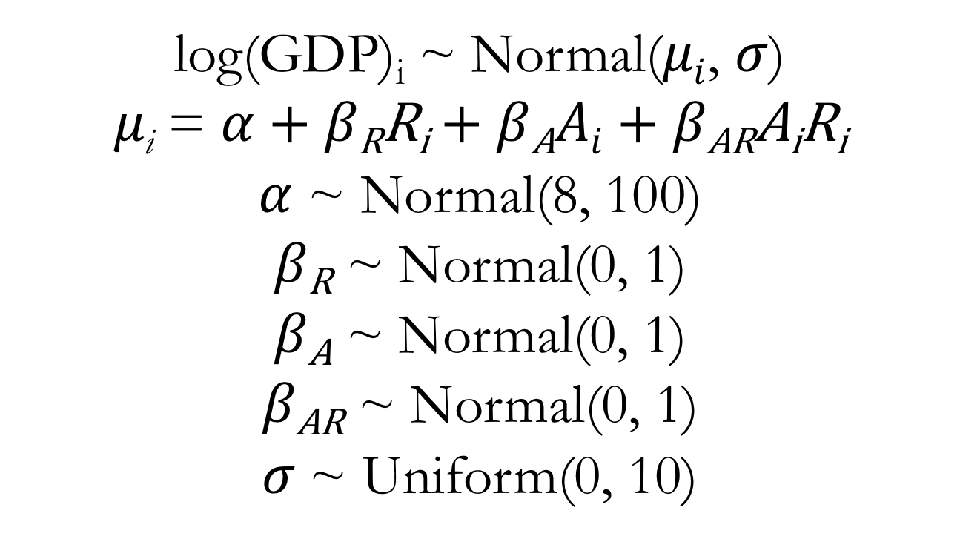
Do Some Math!
log(GDP)_{i} ~ Normal($μi$, $σ$)
$μ\text{i}$ = $α$ + $β\text{R}\text{R}\text{i}$ + $β\text{A}Ai$ + $β\text{AR}\text{A}\text{i}\text{R}\text{i}$
$α$ ~ Normal(8, 100)
$β\text{R}$ ~ Normal(0, 1)
$β\text{A}$ ~ Normal(0, 1)
$β\text{A}\text{R}$ ~ Normal(0, 1)
$σ$~ Uniform(0, 10)

Slide 15
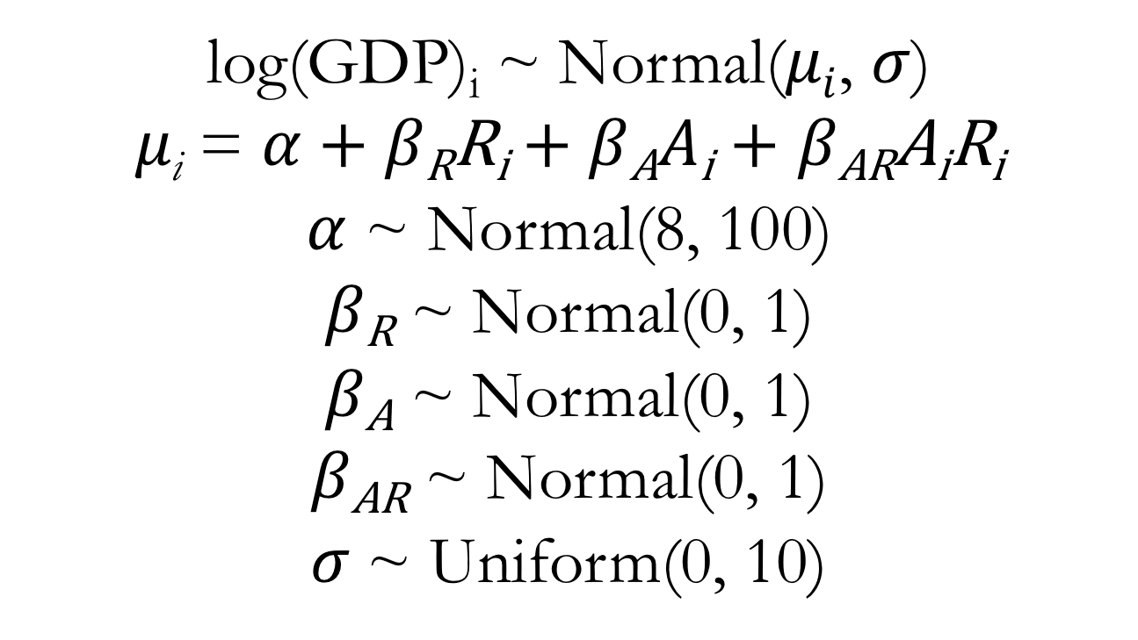
Multiple Regression for GDP (Conventional Form) Predictors: Ruggedness, Continent Identity, and Interaction
log(GDP)_{i} ~ Normal($μi$, $σ$)
$μ\text{i}$ = $α$ + $β\text{R}\text{R}\text{i}$ + $β\text{A}A\text{i}$ + $β\text{AR}\text{A}\text{i}\text{R}\text{i}$
$α$ ~ Normal(8, 100)
$β\text{R}$ ~ Normal(0, 1)
$β\text{A}$ ~ Normal(0, 1)
$β\text{A}\text{R}$ ~ Normal(0, 1)
$σ$~ Uniform(0, 10)

Slide 16
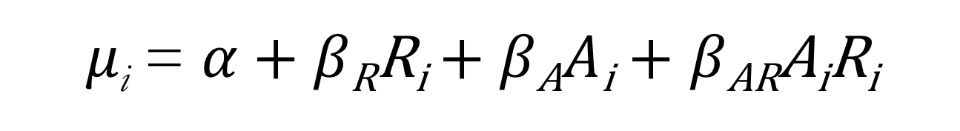
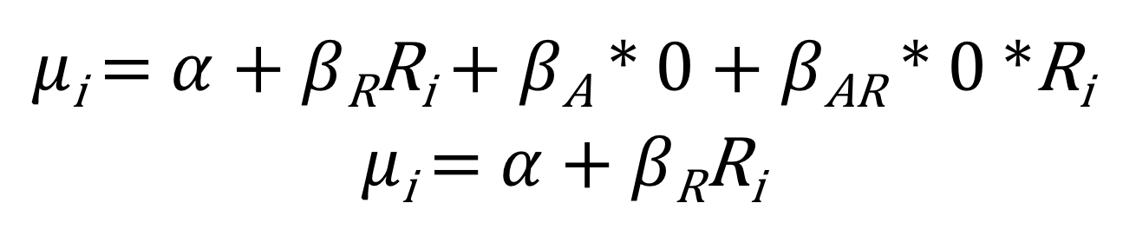
Equation for the Mean
$μ\text{i}$ = $α$ + $β\text{R}\text{R}\text{i}$ + $β\text{A}A\text{i}$ + $β\text{AR}\text{A}\text{i}\text{R}\text{i}$
Outside of Africa: A_{i} = 0
$μ\text{i}$ = $α$ + $β\text{R}\text{R}\text{i}$ + $β\text{A}$ * 0 + $β\text{AR}\text{ * }\text{0 *}\text{R}\text{i}$
$μ\text{i}$ = $α$ + $β\text{R}\text{R}\text{i}$

Slide 17
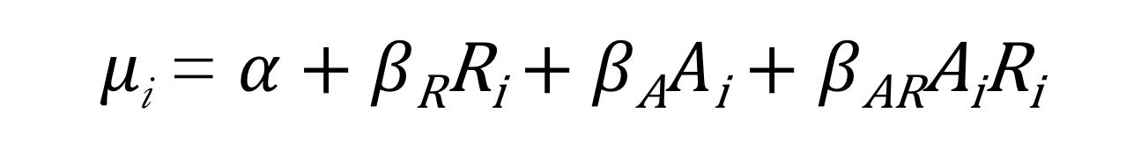
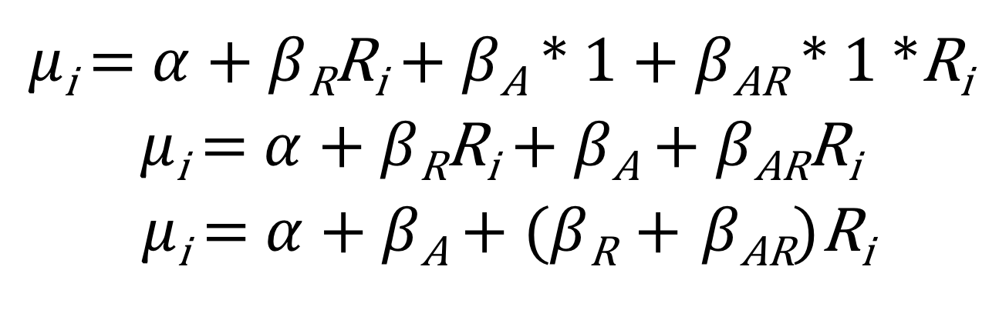
Equation for the Mean
$μ\text{i}$ = $α$ + $β\text{R}\text{R}\text{i}$ + $β\text{A}A\text{i}$ + $β\text{AR}\text{A}\text{i}\text{R}\text{i}$
In Africa: A_{i} = 1
$μ\text{i}$ = $α$ + $β\text{R}\text{R}\text{i}$ + $β\text{A}$ * 1 + $β\text{AR}\text{ * }\text{1 *}\text{R}\text{i}$
$μ\text{i}$ = $α$ + $β\text{R}\text{R}\text{i}$ + $β\text{A}$ + $β\text{AR}\text{R}\text{i}$
$μ\text{i}$ = $α$ + $β\text{A}$ + ($β\text{R} \text{+} β\text{AR}\text{)}\text{R}\text{i}$
Notes:
Go to lecture code for interaction model and plotting

Slide 18
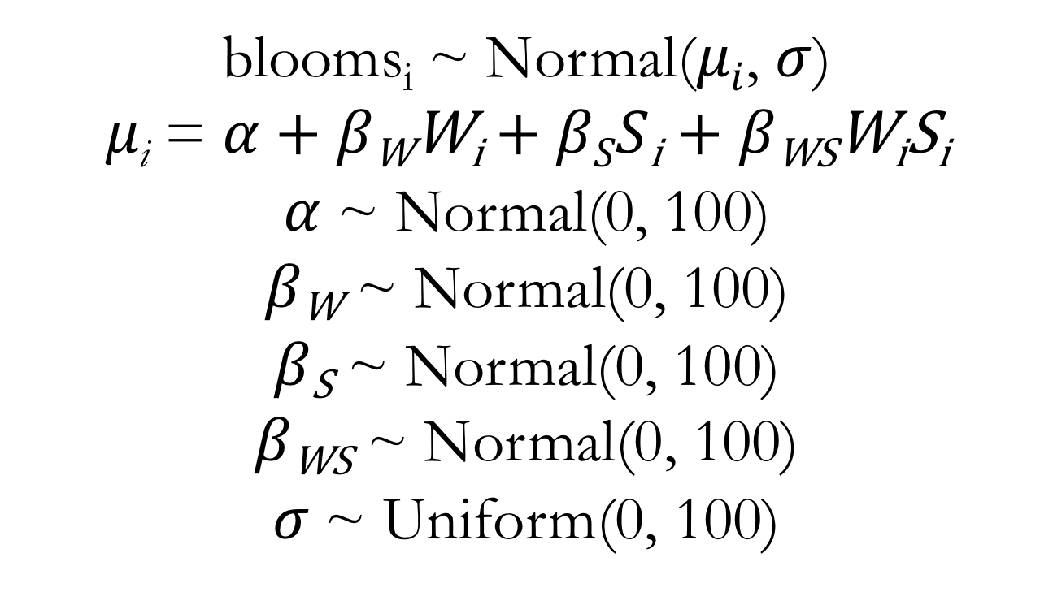
Multiple Regression for Blooms (Conventional Form) Predictors: Water, Shade, and Interaction
blooms_{i} ~ Normal($μi$, $σ$)
$μ\text{i}$ = $α$ + $β\text{W}\text{W}\text{i}$ + $βSS\text{i}$ + $β\text{WS}\text{W}\text{i}\text{S}\text{i}$
$α$ ~ Normal(0, 100)
$β\text{W}$ ~ Normal(0, 100)
$β\text{S}$ ~ Normal(0, 100)
$β\text{WS}$ ~ Normal(0, 100)
$σ$~ Uniform(0, 100)

Slide 19
